Slide 1



Decane
(what is the formula?______________)
Catalyst (broken clay pot or aluminium oxide (Al₂O₃)
water

Slide 2
Decane
(what is the formula?______________)
What is the Structural formula - Draw in your jotter)
H
H
H
H
H
H
H
H
H
H
H
C
C
C
C
C
C
C
C
C
C
H
H
H
H
H
H
H
H
H
H
H

Slide 3
H
H
H
H
H
H
H
H
H
H
H
C
C
C
C
C
C
C
C
C
C
H
H
H
H
H
H
H
H
H
H
H
Decane
Draw 4 isomers of decane
c
c
c
c
c
c
c
c
c
c
c
c
c
c
c
c
c
c
c
c
c
c
c
c
c
c
c
c
c
c
c
c
c
c
c
c
c
c
c
c

Slide 4
When we “crack” DECANE what are the possible products formed?
How do you prove you have formed these products?
H
H
H
H
H
H
H
H
H
H
H
C
C
C
C
C
C
C
C
C
C
H
H
H
H
H
H
H
H
H
H
H
H
H
H
H
H
H
H
H
H
H
H
C
C
C
H
c
c
C
C
C
C
C
H
H
H
H
H
H
H
H
H
H

Slide 5
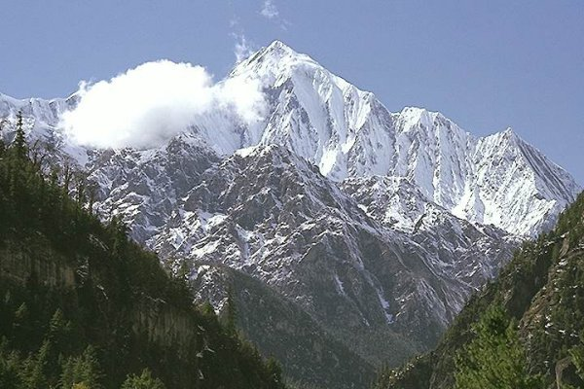
Annapurna

Slide 6
Alkanes
Saturated
(Single Bonds)
Cycloalkanes
Can be
Hydrocarbons
Can be
Unsaturated
(Double Bond)
Ethene
CH₂=CH₂
Alkenes
Pentene
CH₃CH₂CH₂CH=CH₂

Slide 7
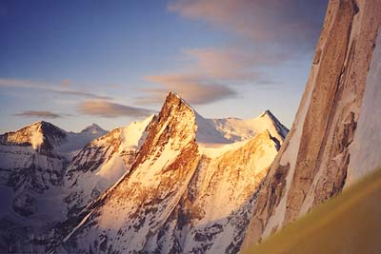

Slide 8
Saturated or Unsaturated?
H
H
H
H
Saturated
Saturated
H
H
H
C
C
C
C
H
C
H
C
C
H
H
H
H
H
H
H
H
H
H
CH₂
CH₂
CH₂
CH₂
C
C
C
H
Saturated
CH₂CHCH₃
Unsaturated
H
H
Unsaturated

Slide 9
Bromine Water
Double Bonds
Undergo
Addition Reactions
Br
Br
H
H
C
C
C
H
In Addition Reactions
The double bond
Breaks and bromine atoms
are added to both sides
of the double bond
H
H
H

Slide 10
Addition of Hydrogen (H₂)
The double bond
Breaks and Hydrogen atoms
are added to both sides
of the double bond
H
H
H
H
C
C
C
H
H
H
H
Propene + Hydrogen
Propane

Slide 11

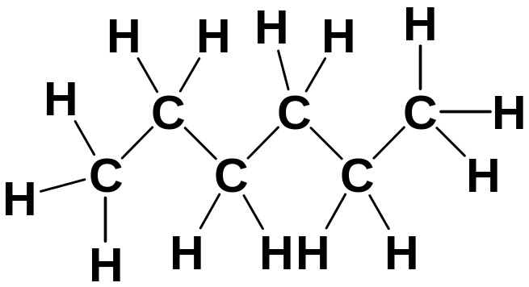
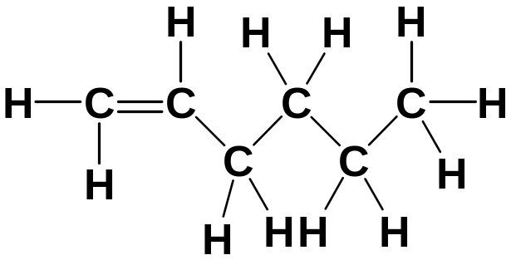

Alkenes into Alkanes
Now write this reactions using the Structural Formulae
1.
Hexene + Hydrogen
Hexane
C₆H₁₂
+
H₂
C₆H₁₄

Slide 12
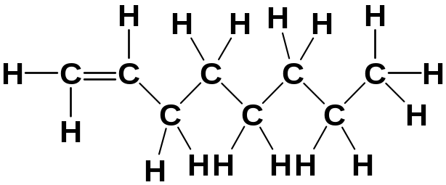
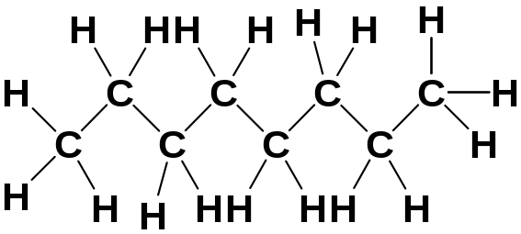
Alkenes into Alkanes
2.
Octene + Hydrogen
Octane
C₈H₁₆
+
H₂
C₈H₁₈

Slide 13
Saturated?
C₂H₆
?
C₁₀H₂₀
C₄H₁₀
C₄H₈
?
C₄H₈?
C₈H₁₈
C₇H₁₄
?
C₂₀H₄₂
?
C₁₁H₂₂
C₆₀H₁₂₂
C₁₅H₃₀
?

Slide 14
Alkenes and Cycloalkanes
Isomers from different Homologous Series
Unsaturated
Alkenes
C_{n}H_{2n}
C₄H₈
Cyclo-
alkanes
C₄H₈
Saturated

Slide 15
C₄H₈
Unsaturated
Saturated
CH₂
CH₂
H
H
H
H
CH₂
CH₂
C
C
C
C
H
Cyclobutane
H
H
H
Unreactive
No Reaction with
Bromine
Butene
Reacts with
Bromine

Slide 16
C₅H₁₀
A
B
Pentene
Cyclopentane
Describe how you could find out, which test tube contained pentene and which test tube contained cyclopentane
Only Tube A decolourised bromine water.

Slide 17
Bromine Water
Alkenes react with Bromine water.
The bromine water changes from brown to clear.
Tube A must contain Pentene
Alkene
Alkane
Bromine Water

Slide 18
This powerpoint was kindly donated to www.worldofteaching.com
http://www.worldofteaching.com is home to over a thousand powerpoints submitted by teachers. This is a completely free site and requires no registration. Please visit and I hope it will help in your teaching.

